Slide 1
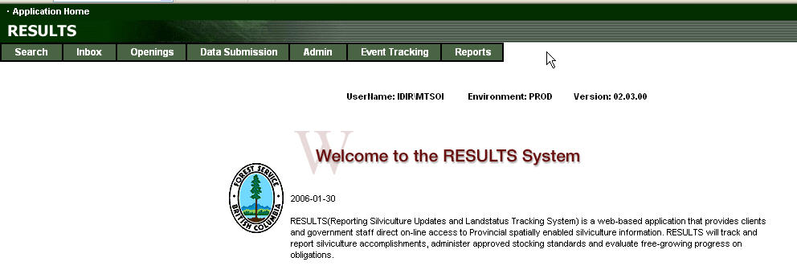
RESULTS FRPA s.108 Application
Presented by Mei-Ching Tsoi
mtsoi@shaw.ca
November 2010

Slide 2
RESULTS FRPA s.108 Application
Training Objectives
Overview of FRPA s.108 – Legislation
Requirements to build s.108 Application using RESULTS
Steps to complete and submit a s.108 Application (Create and Submit)
Steps to complete the processing a s.108 Application (Inbox)
Show key s.108 documentation links
Online demonstration (time permitting)
Questions and Answers

Slide 3
RESULTS FRPA s.108 Application
Out of Scope
Ministry-specific direction on how to collate and process s.108 applications
Rationale for approval of stocking standards (FDP, FSP)
Rationale for approval processes
Funding allocation

Slide 4
s.108 Application - Legislation
FRPA s.108 – Government may fund extra expense or waive obligation
Because of an event causing damage (FPPR s 96 (1.1)), the obligation to establish a free growing stand cannot be met without significant expenses than would have been the case if the damage had not occurred, and
The person
  did not cause or contribute to cause of damage,
  exercised due diligence in relation to the cause of the damage, or
  contributed to the cause of the damage but only as a result of an officially induced error.

Slide 5
s.108 Application - Legislation
Minister must grant
  Relief of obligation, or
  Grant funding to restore stand of trees on the area affected by the event to the stage the stand had reached at the time of damage or to a stage that is consistent with an agreement between the person and the minister.

Slide 6
RESULTS - Up to Date Reporting & Reporting Order Matters
Submissions that must be in RESULTS before the s.108 Application process
  Pre-event forest cover: to reflect pre-catastrophic event stand condition. Note: this should be submitted first if not already in RESULTS.
  Post-event forest cover : to reflect forest stand condition after the catastrophic event.
  Submission of new disturbance activity to reflect catastrophic event

Slide 7
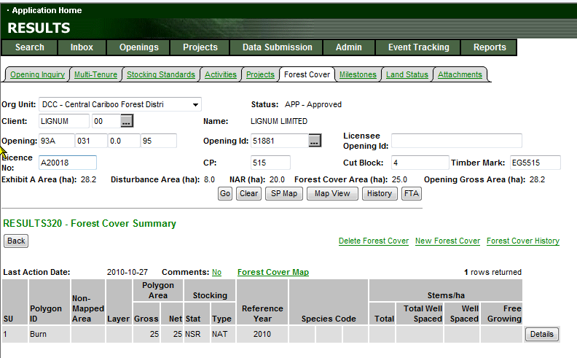
RESULTS – Forest Cover Must be ESF
RISS requires Forest Cover to be submitted via ESF which includes spatial.

Slide 8
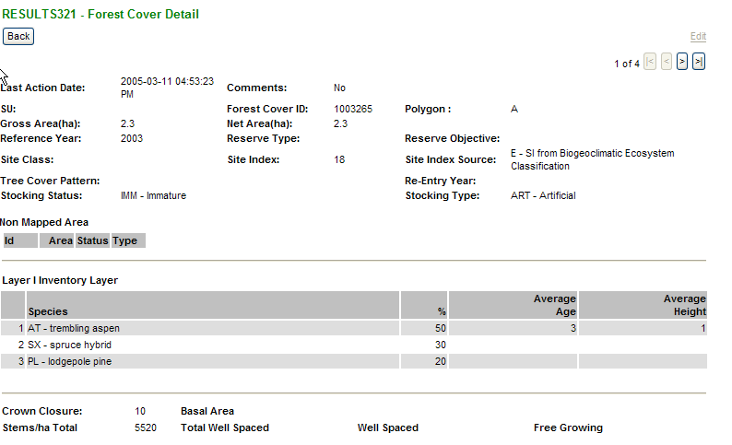
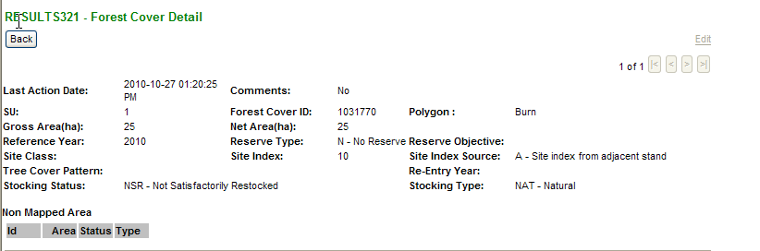
RESULTS – Pre and Post Condition
Ensure Forest Cover Up-to-Date
Pre-Catastrophic Event Forest Cover
Requires forest cover up to stand condition before catastrophic event.
If not in RESULTS, submit this first.
Wait a day.
Then submit forest cover reflecting after the catastrophic event.
Post-Catastrophic Event Forest Cover

Slide 9
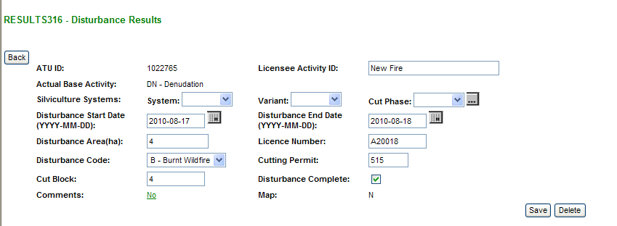
RESULTS – Disturbance Report for Catastrophic Event
Disturbance Record must exist for catastrophic event

Slide 10
RESULTS - Up to Date Reporting & Reporting Order Matters
Requirements to Modify Stocking Standards:
Silviculture Prescription: Create and submit silviculture prescription amendment (requiring approval)
Site Plans: Will need to submit a new stocking standard to the district for approval
    a) Site plans under FDP: New standards must be submitted to RESULTS
    b) Site plans under FSP: New standards must be submitted via the FSPTS and constitute an FSP amendment requiring approval.
    Unless FSP has some language allowing for stocking standards modification via approved variations
    e.g. For standard units where a natural disturbance occurred after area was reforested, the FG/RG offsets may be amended via approved variation to accommodate the disturbance

Slide 11
RESULTS - Up to Date Reporting & Reporting Order Matters
Requirements to Modify Stocking Standards:
    Site plans under FSP:
    FRPA regulation provide 20 years to meet free growing.
    If unable to meet free growing within 20 years, can submit proposal under s.46.2 that includes new free growing date and standards.

Slide 12
s.108 Application – Silv Prescription Amendments
May need to initiate an amendment to accommodate changes caused by catastrophic event (NAR, extension of regeneration and free growing years, etc)
Amendments should be completed and submitted prior to s.108 Application creation.
This ensures the amendment is indicated and reflected in the s.108 Application.
Approval of s.108 Application will also approve silviculture prescription at the same time.
Approver must ensure they review content of the Proposed Amendment in the process of s.108 Application Review

Slide 13
RESULTS – Retain Data Integrity
Do not change the initial disturbance start date for the opening as this still applies to the original obligation of the opening.
Must supply new disturbance to reflect new catastrophic disturbance. The disturbance area should reflect the net area under the s.108 Application seeking relief of obligation or funding request.
New disturbance will not change the regeneration and free growing milestone dates.
Must submit an amendment to extend regeneration & free growing dates and/or modify stocking standards.

Slide 14
RESULTS - Steps
Ensure all pre-requisite information is in RESULTS (pre & post forest cover and natural disturbance report)
If applicable, submit silviculture prescription amendment (if required and if requesting) or if site plan, acquire approved changes to stocking standards if under FDP or FSP.
Initiate s.108 Application and complete required components (DFT)
Submit s.108 Application (SUB)
(Approver) Reviews s.108 Approves or Not Approves s.108 Application
  Once s.108 Application is approved, can no longer be modified (APP) for that application version.
  Not Approved s.108 Application remains in system in DFT status and can be deleted and start new or modified for resubmission.

Slide 15
RESULTS – Application Components
Component | Relief of Obligation | s.108 Application for Funding
Relief of Obligation | ✓
Disturbance Event (Catastrophic Event) | ✓ | ✓
Forest Cover Pre-catastrophic event stand condition and map | ✓ | ✓
Forest Cover Post-catastrophic event stand condition and map | ✓ | ✓
Planned Activity Regime |  | ✓
Silv Amendment, if required Note: site plan amendment do not require approval
Attachments , if required
Eligibility Check Boxes | ✓ | ✓
Authorization Check Box | ✓ | ✓

Slide 16
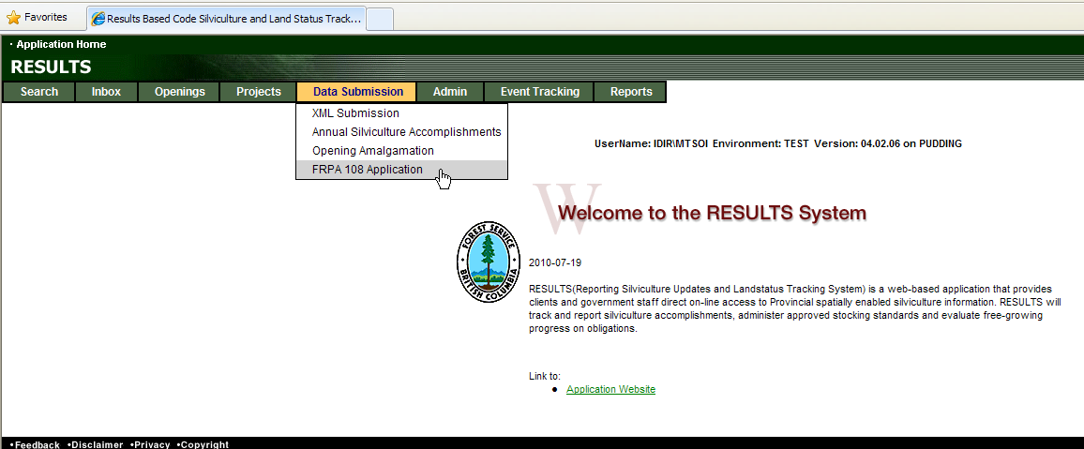
RESULTS – FRPA s.108 Application

Slide 17
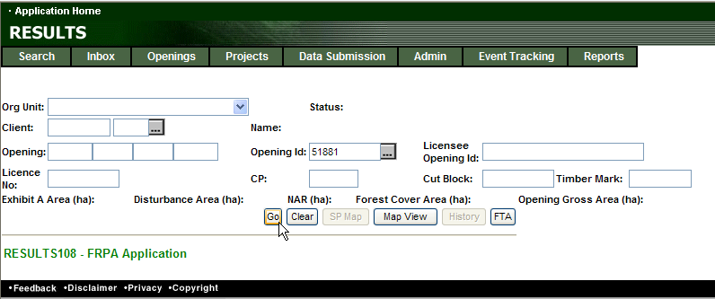
RESULTS – FRPA s.108 Application
Specify Opening for s.108 Application (Hit Go or Enter)

Slide 18
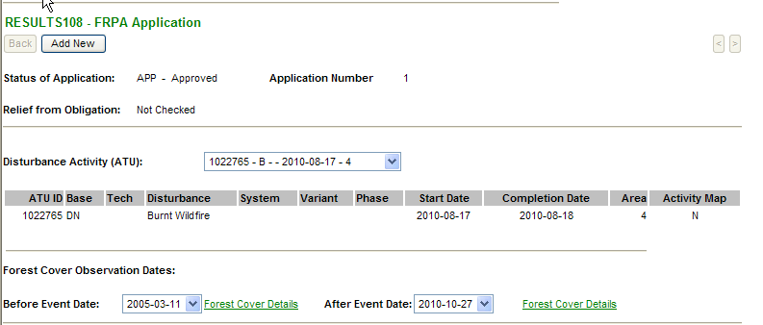
RESULTS – FRPA s.108 Application
Select Add New
Mandatory
Disturbance Event
Pre & Post
Forest Cover
Then Save, located on bottom of page to confirm and initiate application
These are not enterable fields.
They reference existing submitted disturbance and forest cover records.
Must have disturbance pre and post forest cover submitted before initiating s.108 Application process

Slide 19
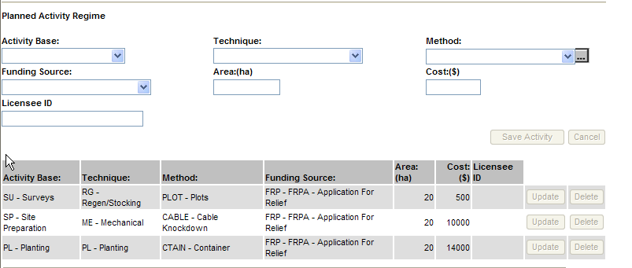
RESULTS – FRPA s.108 Application
Mandatory for Funding Request
Add activities and funding request
Use “FRP-FRPA Application for Relief” funding source
Select “Save Activity”
As each activity is added, the list of s.108 funding activities area/cost will increase.

Slide 20
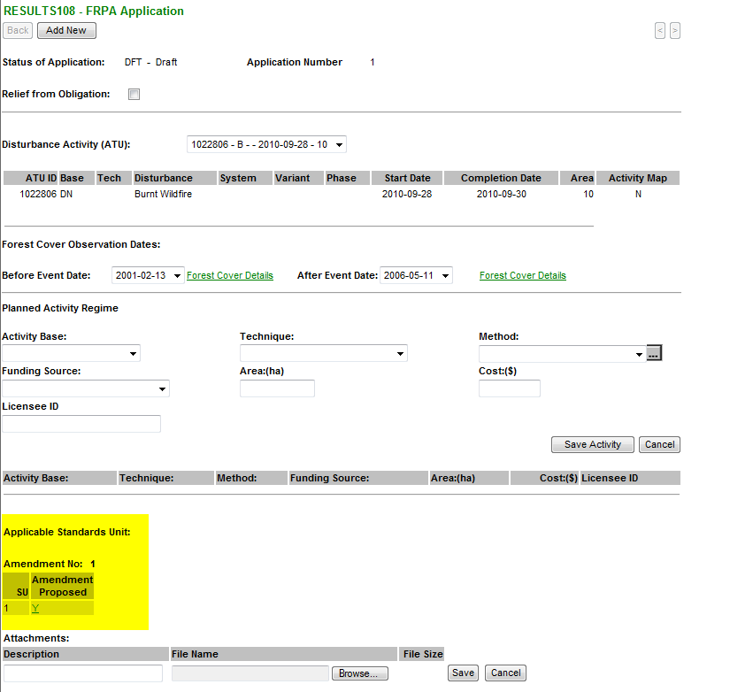
RESULTS – FRPA s.108 Application
Submitted Amendment
Creation S108 Application will show amendment
Submitted Amendment can be viewed at same time by reviewer

Slide 21
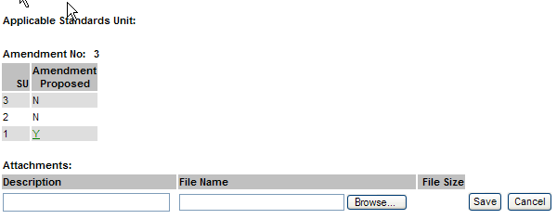

RESULTS – FRPA s.108 Application
Optional
If a silviculture prescription is required and submitted as part of s.108 Application, the SU with required changes are shown and can be viewed.
May use attachment to provide additional information, if required.
If use Attachments please refer to Attachment Standard
Located on RESULTS Business & Policy website under Submission Procedures:
http://www.for.gov.bc.ca/his/results/business.htm
http://www.for.gov.bc.ca/his/results/RESULTS_Attachment_Standard_for_Government_Funded_Programs_20100716.pdf

Slide 22
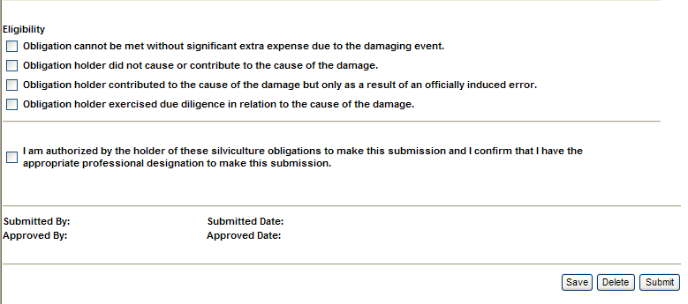
RESULTS – FRPA s.108 Application
Mandatory
Must check required Eligibility Box(s)
Mandatory
Authorization to complete application
Save - After each section is completed to ensure all components are saved
Delete - Will delete entire application
Submit - Will submit application to reviewer. Application’s status changes from DFT to SUB

Slide 23
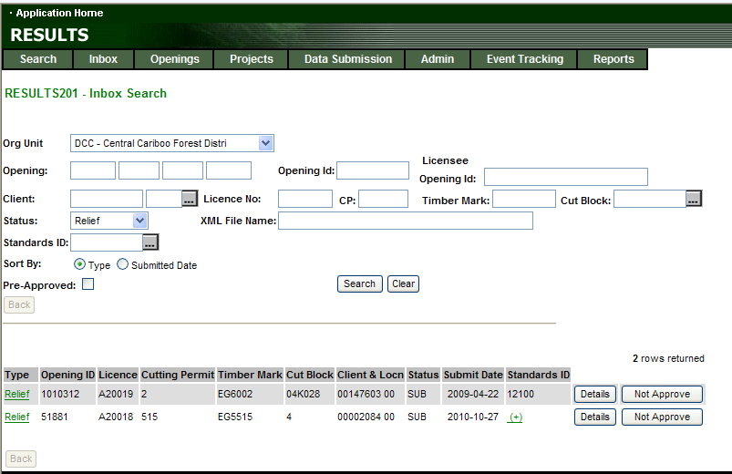
RESULTS – Review s.108 Application – Inbox Processing
Toolbar – Inbox
Status: Relief
Search

Slide 24
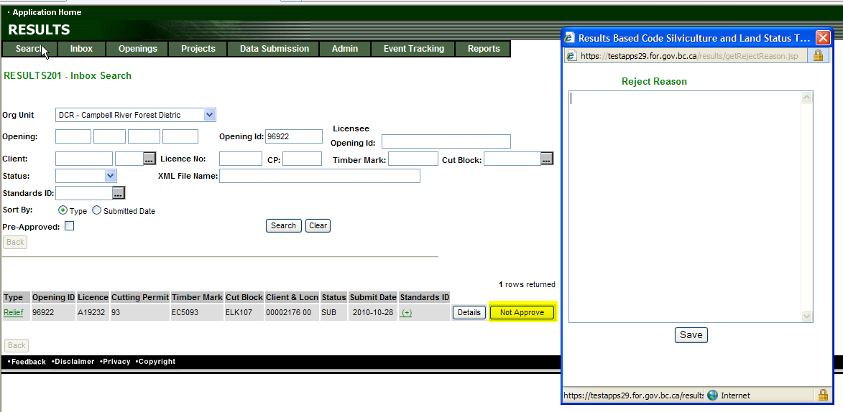
RESULTS – Review s.108 Application – Inbox Processing
Can “Not Approve” from S201 but must provide Reject Reason (mandatory).
To review s.108 – Application – Go to Details
Upon Approval or Not Approve – email notification is sent to submitter

Slide 25
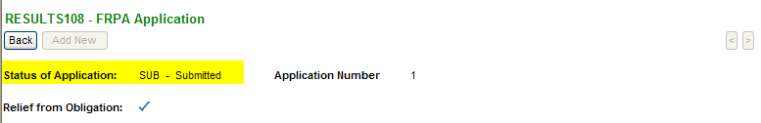
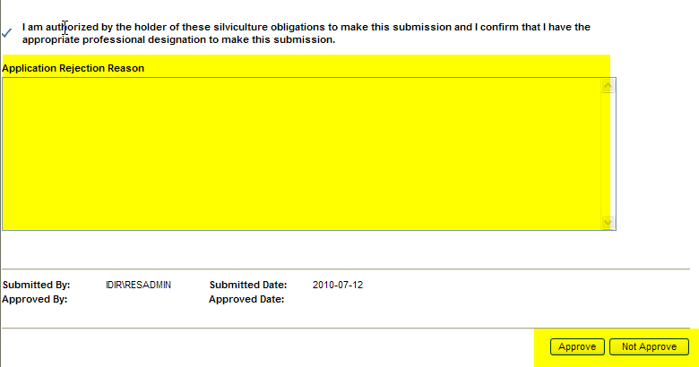
RESULTS – Review s.108 Application – Inbox Processing
Inbox – Details
Must view s.108 Application to access Approval Button.
Not Approval requires completion of the “Application Rejection Reason” text

Slide 26
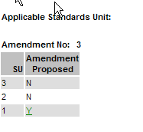
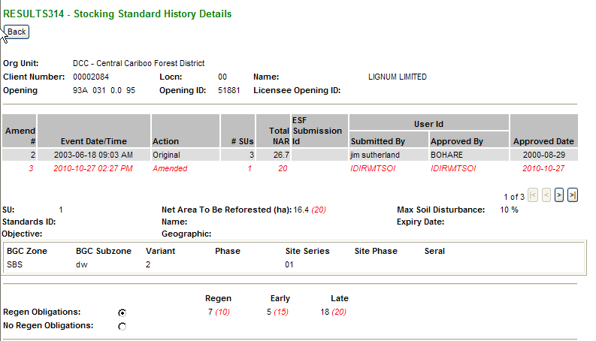
RESULTS –s.108 Application Approval
Silv Prescription Amendment - Approved
Care must be taken to review the Proposed Amendment if supplied with s.108 Application
Silv Prescription amendment is approved at the same time upon s.108 Approval.

Slide 27
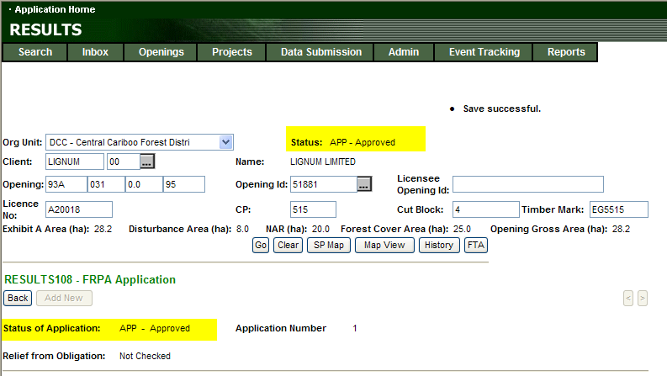
RESULTS –s.108 Application Approval
Approval Changes
Opening Status to Approved – APP
Relief of Obligation Status set to Approved – APP
Approved Application cannot be modified after approval.

Slide 28

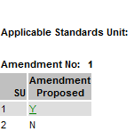
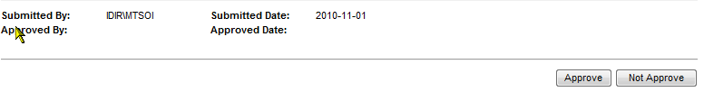
RESULTS – FRPA s.108 Application
S.108 Application Approves s.108 Application AND Silviculture Prescription Amendment as one step.
Make sure review any proposed amendment in s.108 Application

Slide 29
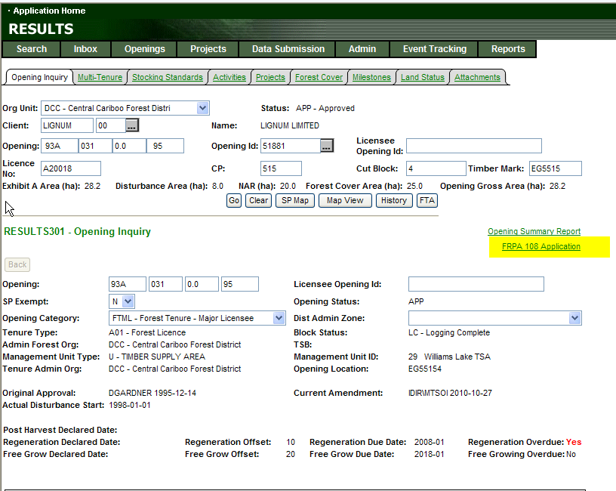
RESULTS –s.108 Application

Slide 30
RESULTS – FRPA s.108 Application
New Catastrophic Disturbance
(online or ESF)
s.108 Application
Inbox
s.108 Application
Ensure Pre-catastrophic Forest Cover exists if not Submit (ESF) – then must wait one day
Complete contents as required
Initiate s.108 Application
Approval of s.108
Application will approve BOTH
s.108 Application AND
Silviculture Prescription Amendment
Opening Status APP
Post catastrophic Forest Cover exists(ESF)
Opening Status SUB
If Required Amendment
Create and Submit Amendment
Submit s.108 Application for Approval
Opening Status APP
Amendment and Approval of FDP or FSP Stocking Standards
Site Plan Amendment

Slide 31
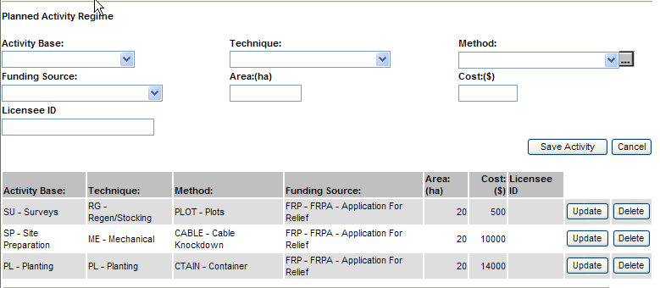
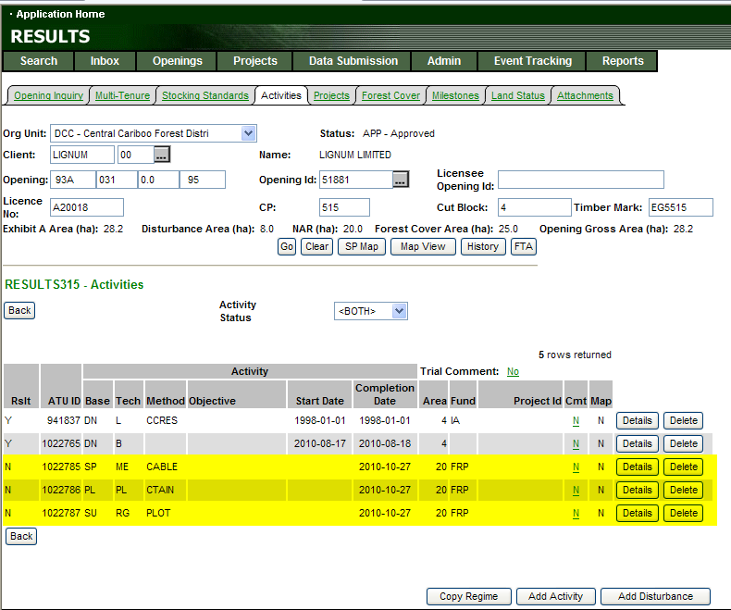
RESULTS –s.108 Application Approval
Placement of Planned Treatments
s.108 Approval
Automatically places all planned activities into S315
Activities as planned activity with planned start date based on approval date.

Slide 32
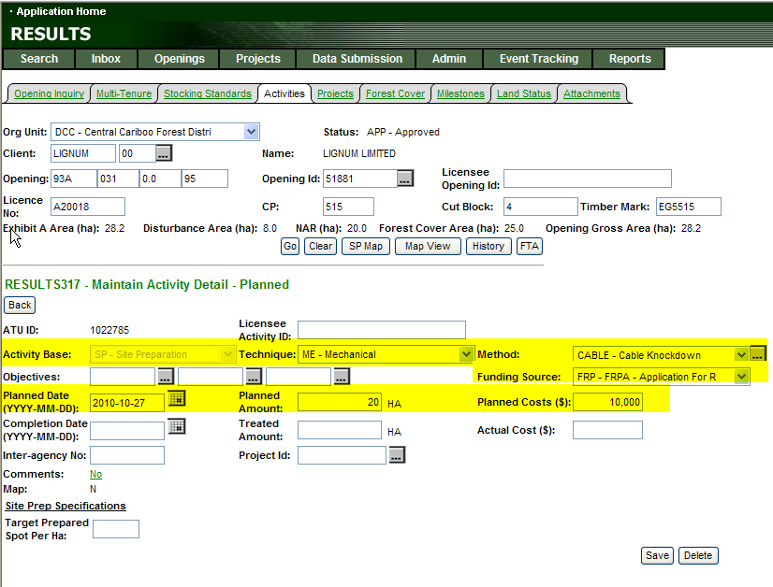
RESULTS –s.108 Application Approval
Placement of Planned Treatments
Planned Activities
Automatically created are:
Base/Tech/Method
Planned Date = s.108 Approval Date
Funding Source Code
Planned Amount (area)
Planned Cost ($)

Slide 33
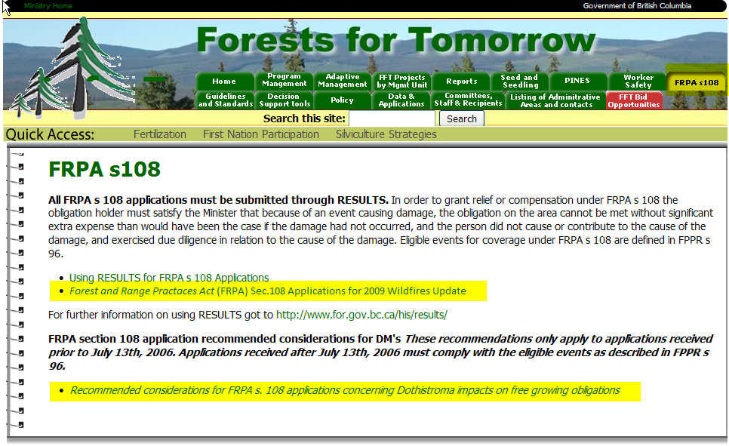
RESULTS –
Communication & documentation http://forestsfortomorrow.com/fft/
Two key documents currently available
Clarification, interpretation and process for approvals
New 2010 information will be communicated

Slide 34
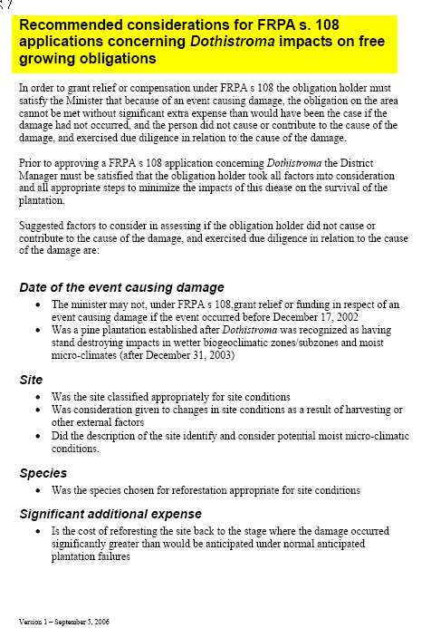
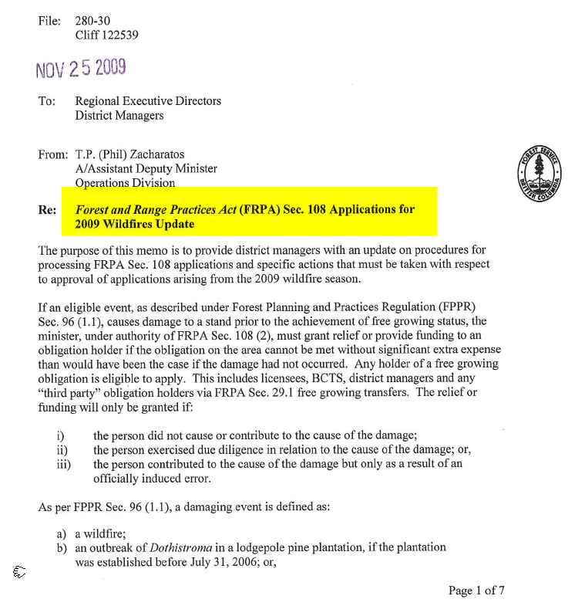
RESULTS –
Communication & documentation http://forestsfortomorrow.com/fft/

Slide 35
RESULTS – Demonstration
Demo

Slide 36
RESULTS – s108 Application
Contact Information
RESULTS s.108 Application Process – APPHELP
Phone: (250) 387-8888
email: FORHISP.APPHELP@gov.bc.ca
s.108 Policy and Procedures – Nigel Fletcher
Phone: (250) 387-8738
email: Nigel.Fletcher@gov.bc.ca
s.108 Funding – Monty Locke
Phone: (250) 356-6987
email: Monty.Locke@gov.bc.ca

